Slide 1


Slide 2

Amit Khaitan
Director (ACA, MBA)
Tel/Fax : +971 6 7408250
Mobile : +971 55 5575049
Email : amit@tajmarble.ae
Website : www.tajmarble.ae
P.O. Box : 70269, Ind. #15, Sharjah, UAE.
Trading in Marble & Granite
Project Management
All kinds of waterjet Design Services
Marble & Granite Cutting Services
Steel Waterjet Cutting

Slide 3


Slide 4


Slide 5


Slide 6
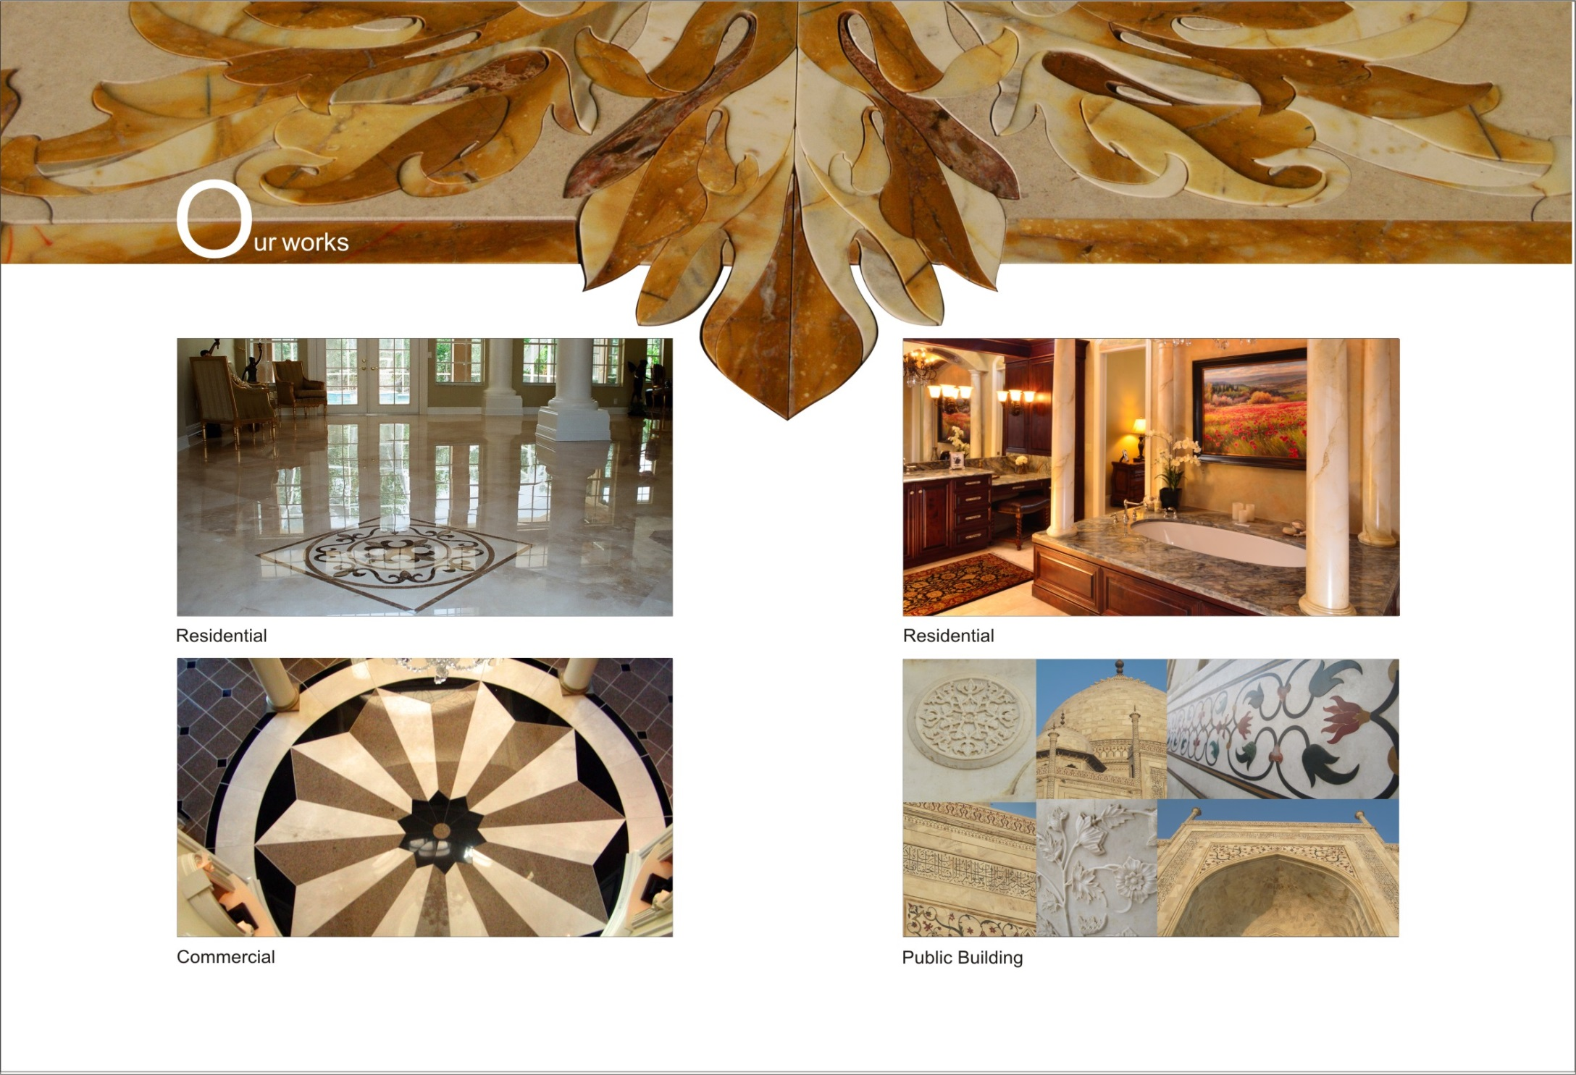

Slide 7


Slide 8
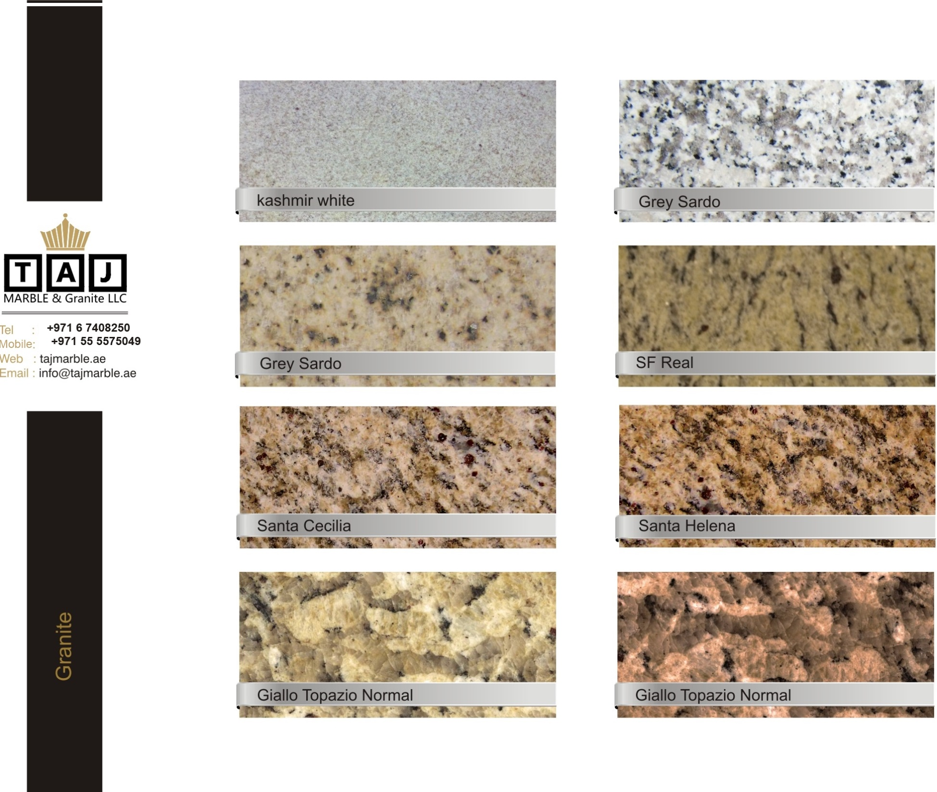

Slide 9
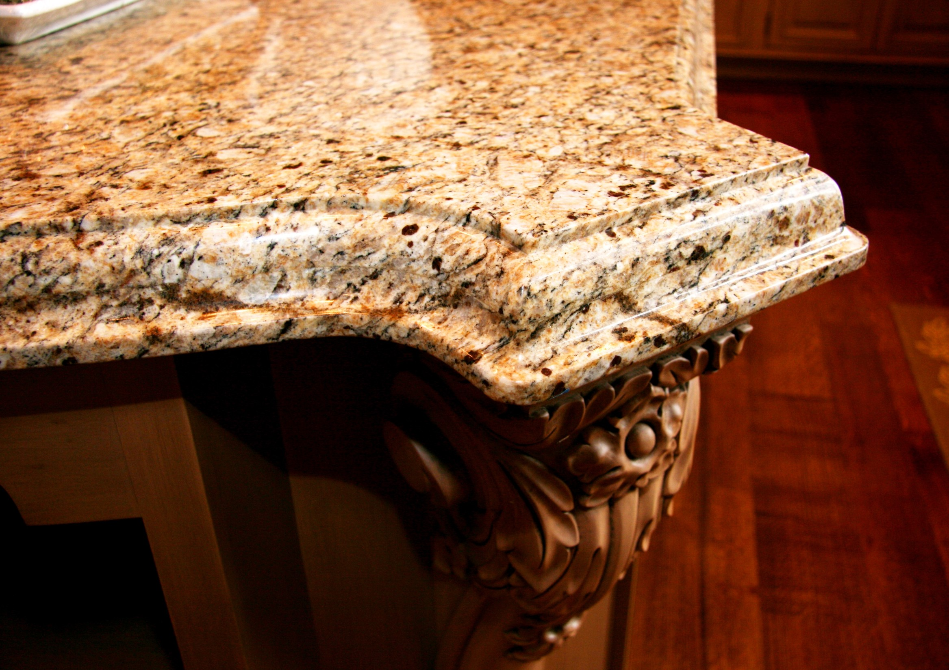

Slide 10


Slide 11


Slide 12


Slide 13
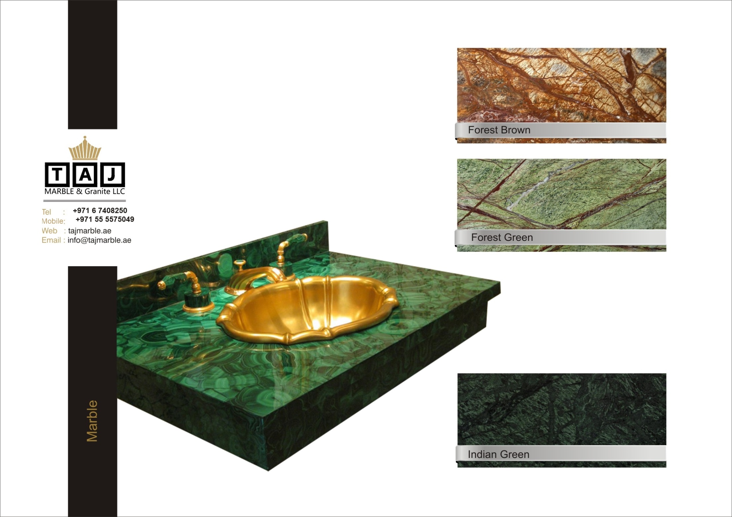

Slide 14
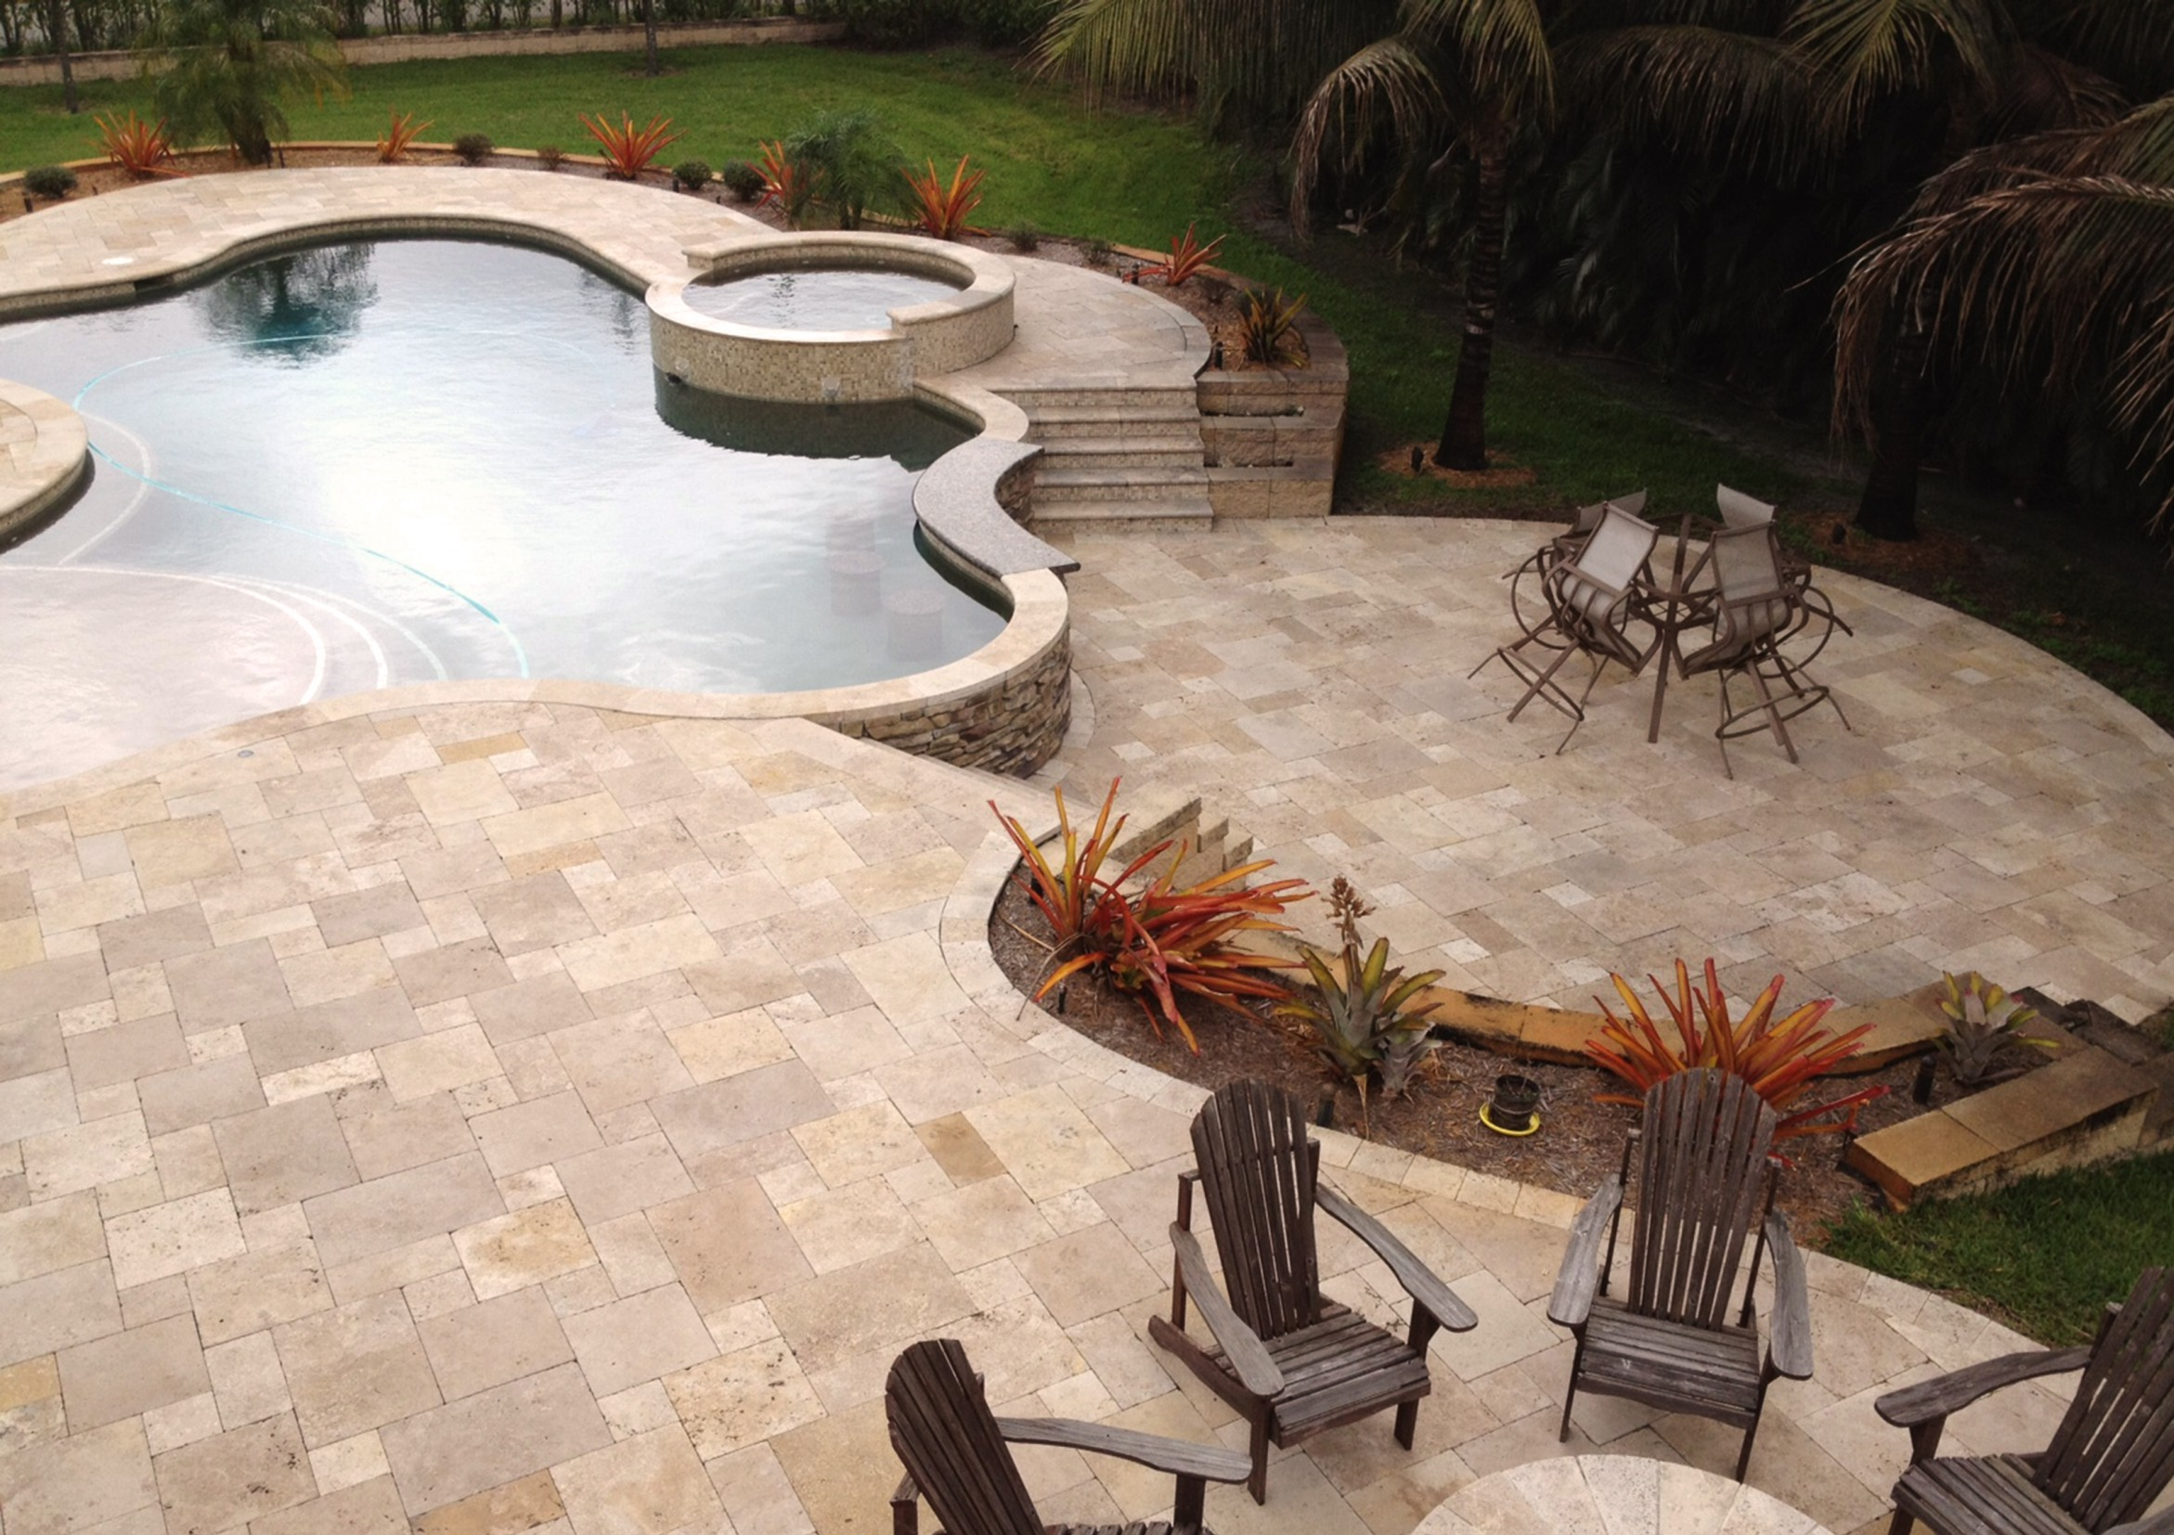

Slide 15
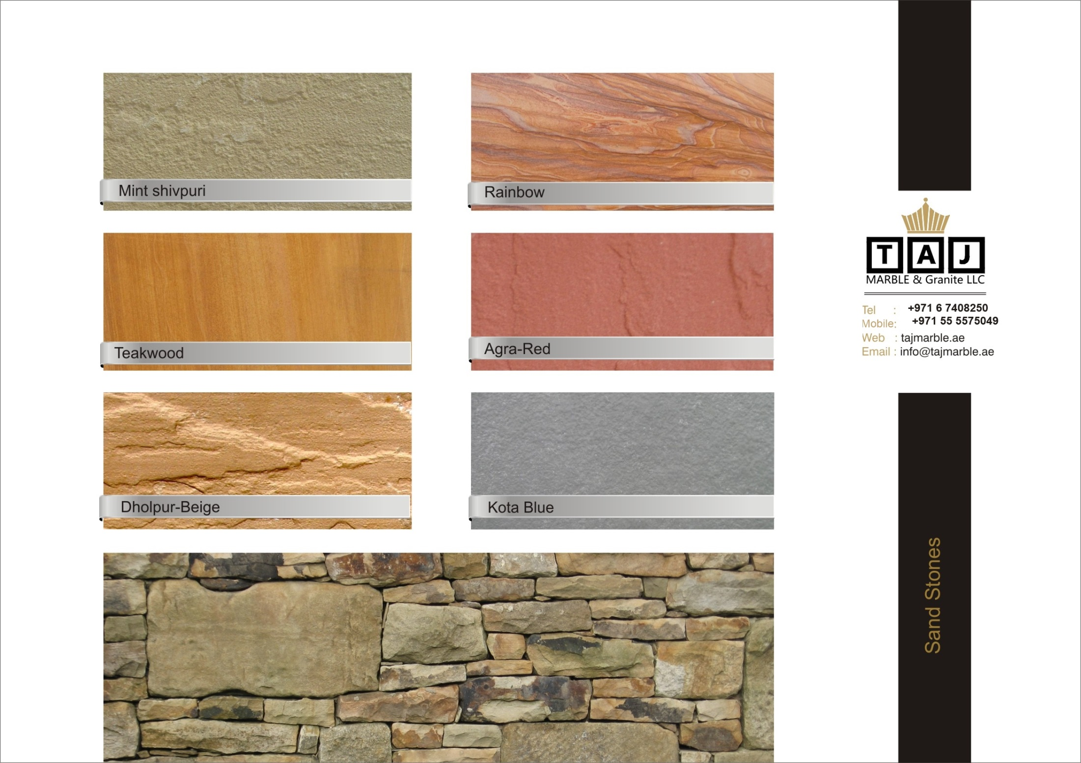

Slide 16
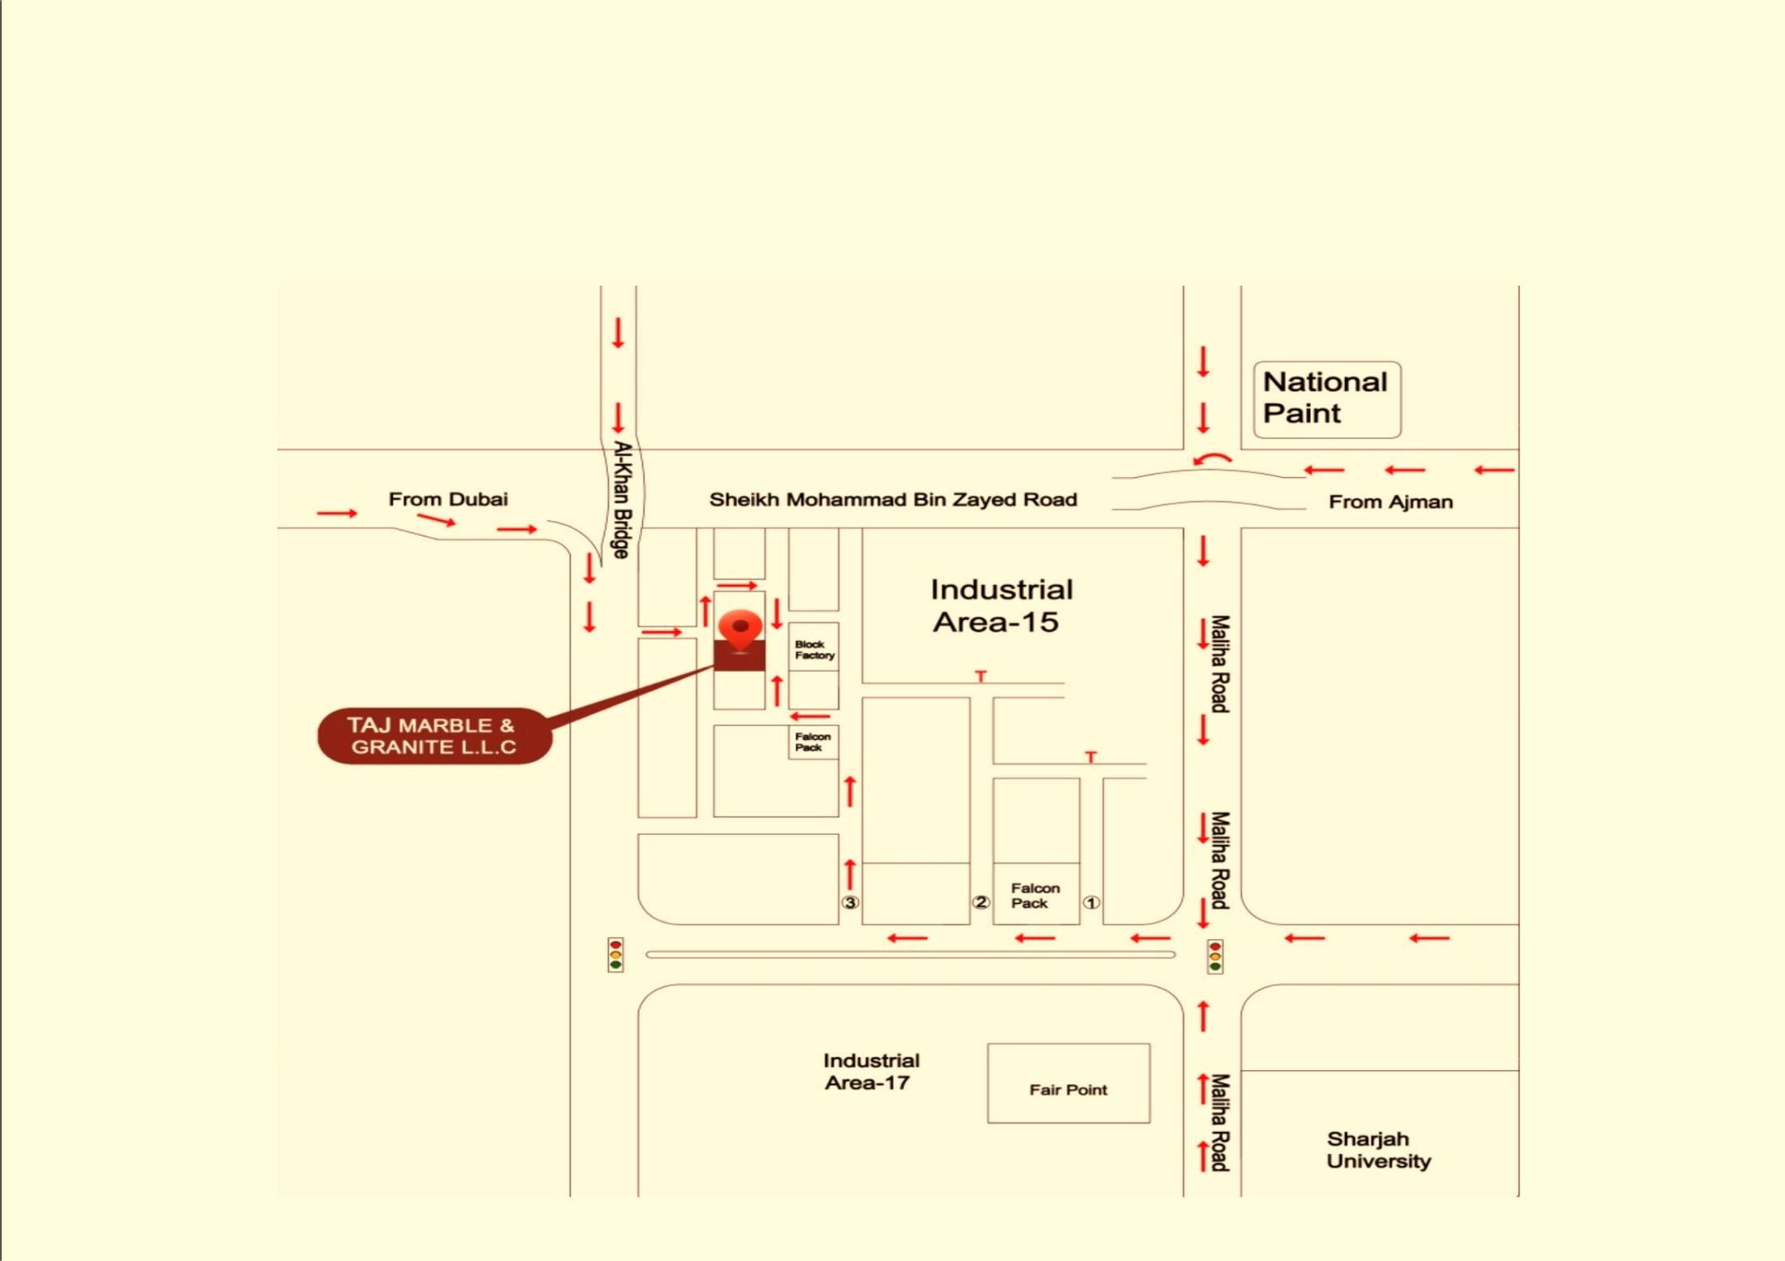
Address: P.O. Box 70269, Sharjah,UAE , Ind. Area 15, Sharjah Tel./Fax: +971 6 740 8250, Mob: +971 55 557 5049 Email: info@tajmarble.ae Website: www.tajmarble.ae

